Slide 1
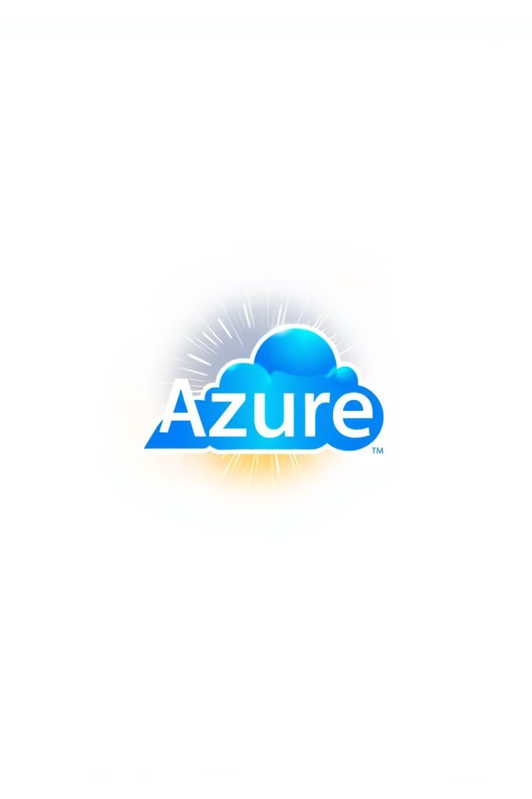
||Azure project 1||
Building a Web Server VM in Azure
This presentation will guide you through the process of creating a web server virtual machine (VM) in Azure, focusing on a Windows operating system.
Created By- || SANRACHNA YANTRA GROUP ||
1.Amber Agarwal (Team Leader)
2.Radhika Maggo
3.Aditya Ojha
4.Akshat Vishwakarma

Slide 2
Azure Resource Manager (ARM) Templates
ARM templates streamline the deployment and management of Azure resources. They define infrastructure and configurations as code, enabling automation, version control, and consistent deployments.
Benefits
Example
Increased efficiency
Deploying a web server VM with a specific network configuration, storage account, and web app service
Reproducible deployments
Simplified resource management

Slide 3

Prerequisites
Before you begin, ensure you have the necessary prerequisites for creating the web server VM.
1
1. Azure Subscription
2
2. Azure Account
An active Azure subscription is essential to create resources in Azure.
You'll need an Azure account with appropriate permissions to create and manage VMs.
3
3. Azure CLI or PowerShell
Azure CLI or PowerShell can be used for automating the deployment process.

Slide 4
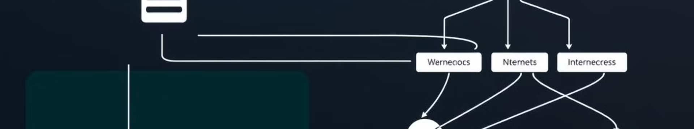
Network Configuration
Configure the network settings for your VM to define its connectivity and security.
Virtual Network
Subnet
Network Security Groups
Create a virtual network (VNet) for the VM to reside in, segmenting your resources and providing network isolation.
Define subnets within the VNet to organize your resources and control network traffic.
Implement Network Security Groups (NSGs) for granular network traffic control, allowing or denying specific traffic based on source, destination, and ports.

Slide 5




Choosing the OS Image
Select the appropriate operating system (OS) image for your web server VM.
Windows Server
Linux Distributions
Container Images
Choose a suitable version of Windows Server, such as Windows Server 2022, based on your application requirements and compatibility.
If your application requires a Linux environment, select a compatible Linux distribution, such as Ubuntu or CentOS.
Consider using container images like Docker for deploying and managing your web server, promoting portability and consistency.

Slide 6
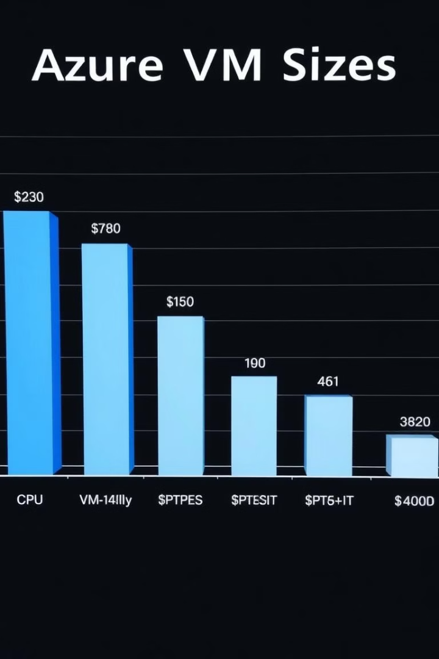
VM Size and Pricing
Choose the right VM size and pricing tier based on your performance and cost considerations.
1
Performance
Select a VM size with enough CPU cores, memory, and storage capacity to meet your application's demands.
2
Pricing
Consider the pricing tiers for the VM size, choosing a cost-effective option while ensuring sufficient resources.
3
Scalability
Factor in scalability requirements and choose a size that allows for future growth or downsizing as needed.

Slide 7




Securing the VM
Secure your web server VM using secure access methods such as SSH or RDP.
SSH Access
Use SSH (Secure Shell) for secure remote access to Linux-based VMs, ensuring encrypted communication.
RDP Access
Use RDP (Remote Desktop Protocol) for secure remote access to Windows-based VMs, providing a graphical interface.
Multi-Factor Authentication (MFA)
Enable MFA for added security, requiring an additional verification step beyond just a password.

Slide 8



Deploying Web Server Software
Deploy the web server software and configure it according to your application's needs.
1
Install Web Server
2
Configure Websites
3
Deploy Application Code

Slide 9
Connecting and Testing
Connect to your web server VM and test your deployment.
1
Connect to VM
2
Verify Server Status
3
Access Website
4
Perform Functional Tests

Slide 10
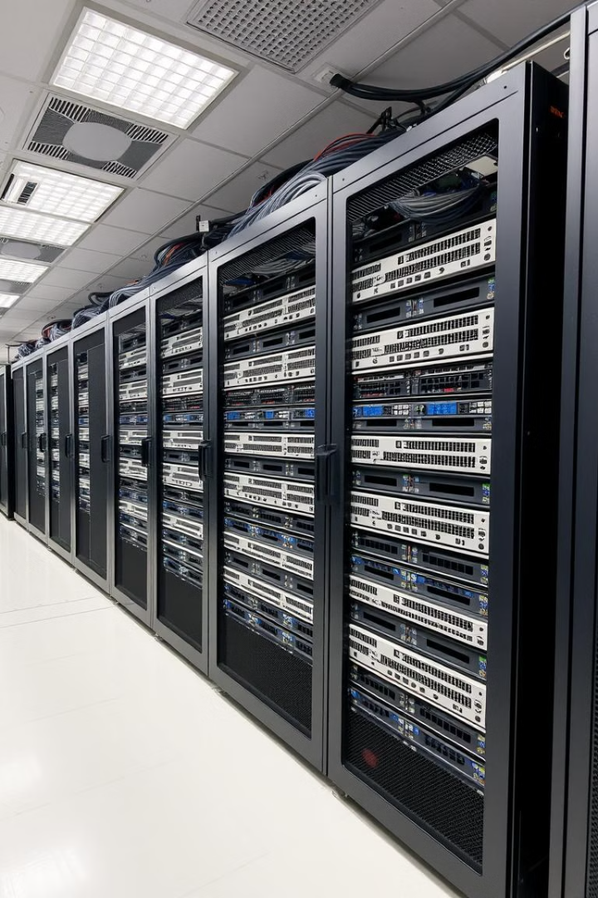
Best Practices for Management
Follow best practices for managing and maintaining your web server VM, ensuring its security and stability.
1
Regular Updates
Keep your operating system and web server software up-to-date with the latest security patches and bug fixes.
2
Monitoring
Monitor your web server VM for performance and security issues, using tools like Azure Monitor to collect and analyze data.
3
Backups
Implement regular backups of your web server data to ensure data recovery in case of unforeseen events.

